Slide 1
5
CHAPTER
METHODS

Slide 2
Chapter Goals
To be able to implement methods
To become familiar with the concept of parameter passing
To develop strategies for decomposing complex tasks into simpler ones
To be able to determine the scope of a variable
To learn how to think recursively (optional)
In this chapter, you will learn how to design and implement your own methods. Using the process of stepwise refinement, you will be able to break up complex tasks into sets of cooperating methods.

Slide 3

Contents
Methods as Black Boxes
Implementing Methods
Parameter Passing
Return Values
Methods without Return Values
Stepwise Refinement
Variable Scope
Recursive Methods (optional)

Slide 4
5.1 Methods as Black Boxes
A method is a sequence of instructions with a name
You declare a method by defining a named block of code
You call a method in order to execute its instructions
public static void main(String[] args)
{
double z = Math.pow(2, 3);
. . .
}
A method packages a computation consisting of multiple steps into a form that can be easily understood and reused.

Slide 5
What is a method?
Some methods you have already used are:
Math.pow()
String.length()
Character.isDigit()
Scanner.nextInt()
main()
They all have:
A name
Follow the same rules as variable names
( ) at the end
A place to receive input information

Slide 6
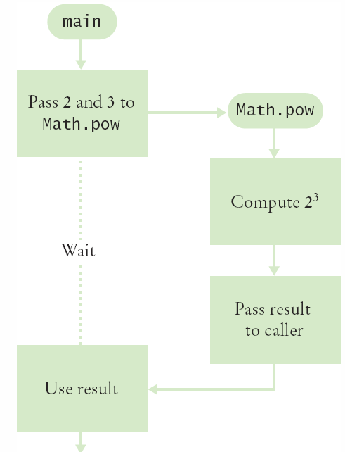
Flowchart of Calling a Method
public static void main(String[] args)
{
double z = Math.pow(2, 3);
. . .
}
One method ‘calls’ another
main calls Math.pow()
Passes two variables
2 and 3
Math.pow starts
Uses variables (2, 3)
Does its job
Returns the answer
main uses result

Slide 7

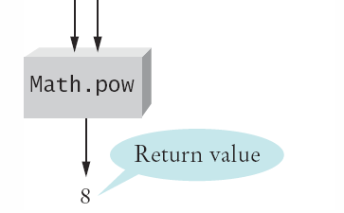
Parameters and Return Values
public static void main(String[] args)
{
double z = Math.pow(2, 3);
. . .
}
main ‘passes’ two parameters to Math.pow
Math.pow calculates and returns a value of 8 to main
main stores the return value to variable ‘z’

Slide 8

Black Box Analogy
A thermostat is a ‘black box’
Set a desired temperature
Turns on heater/AC as required
You don’t have to know how it really works!
How does it know the current temp?
What signals/commands does it send to the heater or A/C?
Use methods like ‘black boxes’
Pass the method what it needs to do it’s job
Receive the answer

Slide 9
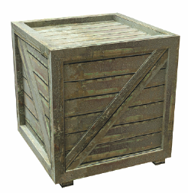
5.2 Implementing Methods
A method to calculate the volume of a cube
What does it need to do its job?
What does it answer with?
When writing this method:
Pick a name for the method (cubeVolume).
Give a type and a name for each parameter variable (double sideLength)
Specify the type of the return value ( double )
Add modifiers such as public static
When declaring a method, you provide a name for the method, a name and type for each parameter, and a type for the result
public static double cubeVolume(double sideLength)

Slide 10
Inside the Box
Then write the body of the method
The body is surrounded by curly braces { }
The body contains the variable declarations and statements that are executed when the method is called
It will also return the calculated answer
public static double cubeVolume(double sideLength)
{
double volume = sideLength * sideLength * sideLength;
return volume;
}

Slide 11
Back from the Box
The values returned from cubeVolume are stored in local variables inside main
The results are then printed out
public static void main(String[] args)
{
double result1 = cubeVolume(2);
double result2 = cubeVolume(10);
System.out.println("A cube of side length 2 has volume " + result1);
System.out.println("A cube of side length 10 has volume " + result2);
}

Slide 12
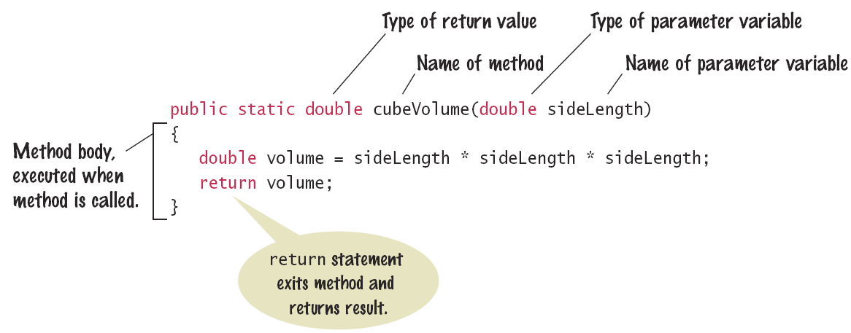
Syntax 5.1: Method Declaration

Slide 13
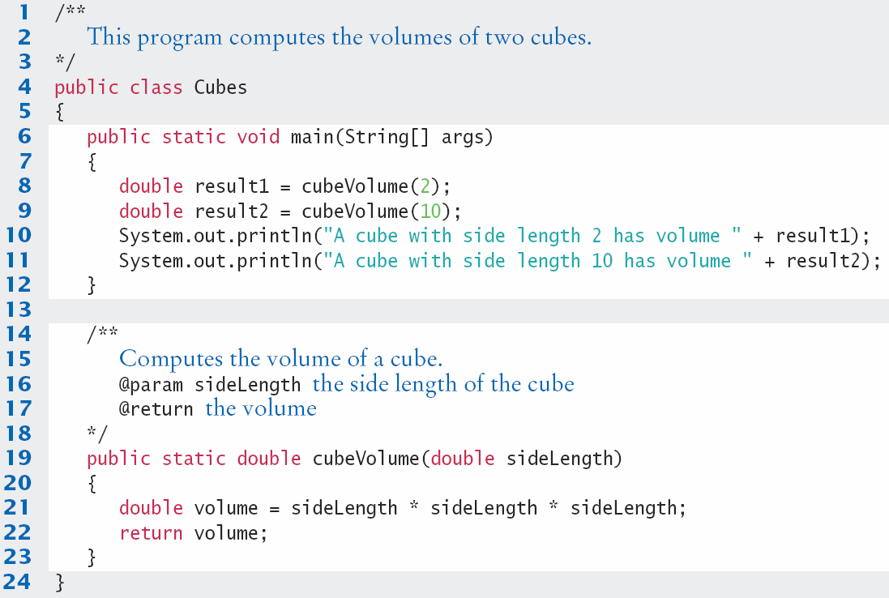
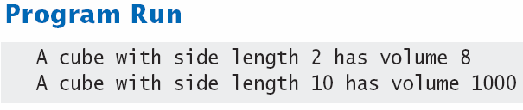
Cubes.java

Slide 14

Method comments
Start with /** (Javadoc multiline comment)
Note the purpose of the method
Describe each parameter
Describe the return value
End with */
/**
Computes the volume of a cube.
@param sideLength the side length of the cube
@return the volume
*/
public static double cubeVolume(double sideLength)

Slide 15
Repeated code into a method
Find Repetitive Code
May have different values but same logic
int hours;
do
{
System.out.print("Enter a value between 1 and 12: ");
hours = in.nextInt();
}
while (hours < 1 || hours > 12);
int minutes;
do
{
System.out.print("Enter a value between 0 and 59: ");
minutes = in.nextInt();
}
while (minutes < 0 || minutes > 59);
1 - 12
0 - 59

Slide 16
Write a ‘Parameterized’ Method
/**
Prompts a user to enter a value in a given range until the user
provides a valid input.
@param low the low end of the range
@param high the high end of the range
@return the value provided by the user
*/
public static int readValueBetween(int low, int high)
{
int input;
do
{
System.out.print("Enter between " + low + " and " + high + ": ");
Scanner in = new Scanner(System.in);
input = in.nextInt();
}
while (input < low || input > high);
return input;
}
1, 12
0, 59
8

Slide 17
5.3 Parameter Passing
Parameter variables hold the parameter values supplied in the method call
They both must be the same type
The parameter value may be:
The contents of a variable
A ‘literal’ value (2)
aka. ‘actual parameter’ or argument
The parameter variable is:
Named in the called method declaration
Used as a variable inside the called method
aka. ‘formal parameter’
Calling Method
out
Parameter value
Parameter variable
in
Called Method

Slide 18




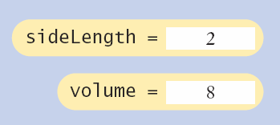
Parameter Passing Steps
public static void main(String[] args)
{
double result1 = cubeVolume(2);
. . .
}
public static double cubeVolume(double sideLength)
{
double volume = sideLength * sideLength * sideLength;
return volume;
}

Slide 19

Common Error 5.1
Trying to Modify Parameters
A copy of the parameter values is passed
Called method (addTax) can modify local copy (price)
But not original
in calling method
total
public static void main(String[] args)
{
double total = 10;
addTax(total, 7.5);
}
total
10.0
copy
public static int addTax(double price, double rate)
{
double tax = price * rate / 100;
price = price + tax; // Has no effect outside the method
return tax;
}
price
10.75

Slide 20
5.4 Methods with Return Values
Methods can (optionally) return one value
The return type is specified in the method declaration
The return statement does two things:
The method terminates immediately
The return value is returned to the calling method
Return type
public static double addTax(double price, double rate)
{
price += price * rate / 100;
return price;
}
The return value may be a value, a variable or a calculation
Type must match return type
Return value

Slide 21
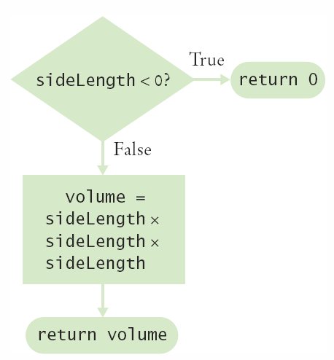
Multiple return Statements
A method can use multiple return statements
But Every branch must have a return statement
public static double cubeVolume(double sideLength)
{
if (sideLength < 0)
{
return 0;
}
return sideLength * sideLength * sideLength;
}

Slide 22
Common Error 5.2
Missing Return Statement
Make sure all conditions are handled
In this case, x could be equal to 0
No return statement for this condition
The compiler will complain if any branch has no return statement
public static int sign(double x)
{
if (x < 0) { return -1; }
if (x > 0) { return 1; }
// Error: missing return value if x equals 0
}

Slide 23
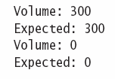
Implementing a Method Steps
Describe what the method should do
Determine the method’s inputs
Determine the types of inputs and the return value
Write pseudocode for the desired result
Implement the method body
Test the method
Design test cases and code
public static double pyramidVolume(double height, double baseLength)
{
double baseArea = baseLength * baseLength;
return height * baseArea / 3;
}

Slide 24

5.5 Methods without Return Values
Methods are not required to return a value
The return type of void means nothing is returned
No return statement is required
The method can generate output though!
...
boxString(“Hello”);
...
public static void boxString(String str)
{
int n = str.length();
for (int i = 0; i < n + 2; i++)
{ System.out.print("-"); }
System.out.println();
System.out.println("!" + str + "!");
for (int i = 0; i < n + 2; i++)
{ System.out.print("-"); }
System.out.println();
}

Slide 25
Using return Without a Value
You can use the return statement without a value
In methods with void return type
The method will terminate immediately!
public static void boxString(String str)
{
int n = str.length();
if (n == 0)
{
return; // Return immediately
}
for (int i = 0; i < n + 2; i++) { System.out.print("-"); }
System.out.println();
System.out.println("!" + str + "!");
for (int i = 0; i < n + 2; i++) { System.out.print("-"); }
System.out.println();
}

Slide 26
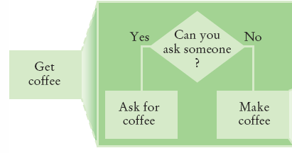
5.6 Stepwise Refinement
To solve a difficult task, break it down into simpler tasks
Then keep breaking down the simpler tasks into even simpler ones, until you are left with tasks that you know how to solve

Slide 27
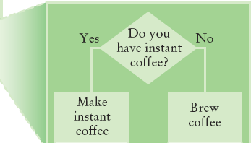
Get Coffee
If you must make coffee, there are two ways:
Make Instant Coffee
Brew Coffee

Slide 28
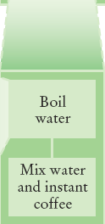
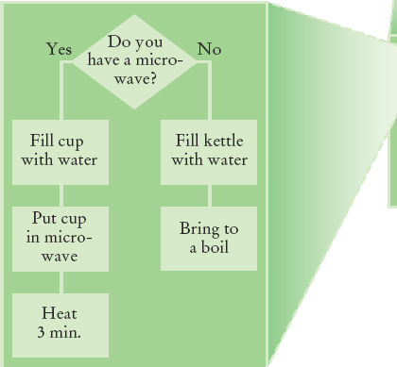
Instant Coffee
Two ways to boil water
1) Use Microwave
2) Use Kettle on Stove

Slide 29

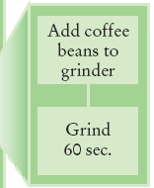
Brew Coffee
Assumes coffee maker
Add water
Add filter
Grind Coffee
Add beans to grinder
Grind 60 seconds
Fill filter with ground coffee
Turn coffee maker on
Steps are easily done

Slide 30

Programming Example
When printing a check, it is customary to write the check amount both as a number (“€274.15”) and as a text string (“two hundred seventy four dollars and 15 cents”). Write a program to turn a number into a text string.
Wow, sounds difficult!
Break it down
Let’s take the dollar part (274) and come up with a plan
Take an Integer from 0 – 999
Return a String
Still pretty hard…

Slide 31
Programming Example
Let’s take it digit by digit (274) – left to right
Handle first digit (hundreds)
If empty, we’re done with hundreds
Get first digit (Integer from 1 – 9)
Get digit name (“one”, “two ”, “three”…)
Add “ hundred”
Sounds easy!
Second digit (tens)
Get second digit (Integer from 0 – 9)
If 0, we are done with tens… handle third digit
If 1, … let’s see… eleven, twelve.. Teens.. Not easy!
Let’s look at each possibility left (1x-9x)…

Slide 32
Programming Example
If second digit is a 0
Get third digit (Integer from 0 – 9)
Get digit name (“”, “one”, “two”…) … Same as before?
Sounds easy!
If second digit is a 1
Get third digit (Integer from 0 – 9)
Return a String (“ten”, “eleven”, “twelve”…)
Sounds easy!
If second digit is a 2-9
Start with string “twenty”, “thirty”, “forty”…
Get third digit (Integer from 0 – 9)
Get digit name (“”, “one”, “two”…) … Same as before?
Sounds easy!

Slide 33
Name the Sub-Tasks
digitName
Takes an Integer from 0 – 9
Return a String (“”, “one”, “two”…)
tensName (second digit >= 20)
Takes an Integer from 0 – 9
Return a String (“twenty”, “thirty”…) plus
digitName(third digit)
teenName
Takes an Integer from 0 – 9
Return a String (“ten”, “eleven”…)

Slide 34
Write Pseudocode
part = number (The part that still needs to be converted)
name = "" (The name of the number)
If part >= 100
name = digitName(part / 100) + " hundred"
Remove hundreds from part.
If part >= 20
Append tensName(part) to name.
Remove tens from part.
Else if part >= 10
Append teenName(part) to name.
part = 0
If (part > 0)
Append digitName(part) to name.
Identify methods that we can use (or re-use!) to do the work.

Slide 35
Plan The Methods
Decide on name, parameter(s) and types and return type
String digitName (int number)
Return a String (“”, “one”, “two”…)
String tensName (int number)
Return a String (“twenty”, “thirty”…) plus
Return from digitName(thirdDigit)
String teenName (int number)
Return a String (“ten”, “eleven”…)

Slide 36
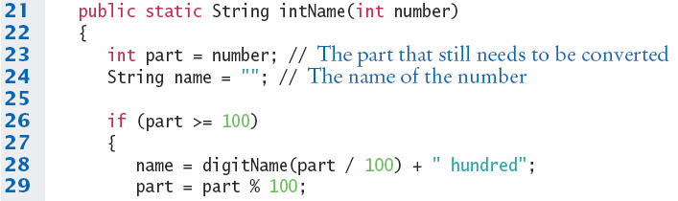
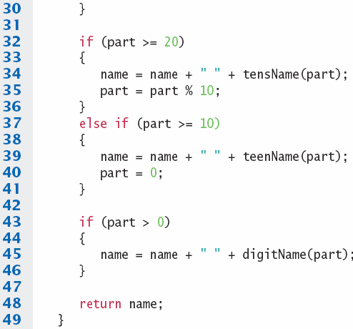
Convert to Java: intName method
main calls intName
Does all the work
Returns a String
Uses methods:
tensName
teenName
digitName

Slide 37
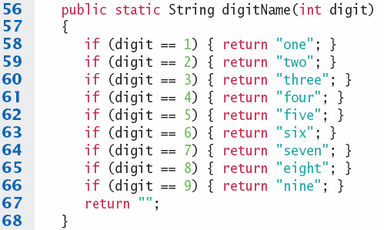
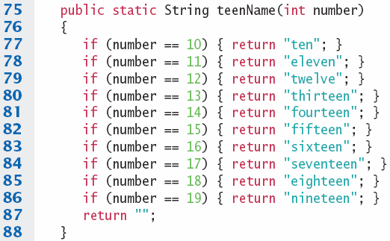
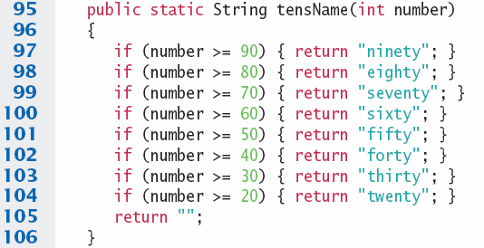

digitName, teenName, tensName

Slide 38



Programming Tips
Keep methods short
Generally one screen
Break into ‘sub’ methods if code is too long
Trace your methods
Use Stubs as you write larger programs
Unfinished methods that return a ‘dummy’ value
public static String digitName(int digit)
{
return "mumble";
}

Slide 39
5.7 Variable Scope
The scope of a variable is the part of the program in which
it is visible.
Variables can be declared:
Inside a method
Known as ‘local variables’
Only available inside this method
Parameter variables are like local variables
Inside a block of code { }
Sometimes called ‘block scope’
If declared inside block { ends at end of block }
Outside of a method
Sometimes called ‘global scope’
Can be used (and changed) by code in any method
How do you choose?

Slide 40
Examples of Scope
sum is a local variable in main
square is only visible inside the for loop block
i is only visible inside the for loop
public static void main(String[] args)
{
int sum = 0;
for (int i = 1; i <= 10; i++)
{
int square = i * i;
sum = sum + square;
}
System.out.println(sum);
}
sum
i
square
The scope of a variable is the part of the program in which
it is visible.

Slide 41
Local Variables of Methods
Variables declared inside one method are not visible to other methods
sideLength is local to main
This will cause a compiler error
public static void main(String[] args)
{
double sideLength = 10;
int result = cubeVolume();
System.out.println(result);
}
public static double cubeVolume()
{
return sideLength * sideLength * sideLength; // ERROR
}

Slide 42
Re-using names for local variables
Variables declared inside one method are not visible to other methods
result is local to square and result is local to main
They are two different variables and do not overlap
public static int square(int n)
{
int result = n * n;
return result;
}
public static void main(String[] args)
{
int result = square(3) + square(4);
System.out.println(result);
}
result
result

Slide 43
Re-using names for block variables
Variables declared inside one block are not visible to other methods
i is inside the first for block and i is inside the second
They are two different variables and do not overlap
public static void main(String[] args)
{
int sum = 0;
for (int i = 1; i <= 10; i++)
{
sum = sum + i;
}
for (int i = 1; i <= 10; i++)
{
sum = sum + i * i;
}
System.out.println(sum);
}
i
i

Slide 44
Overlapping Scope
Variables (including parameter variables) must have unique names within their scope
n has local scope and n is in a block inside that scope
The compiler will complain when the block scope n is declared
public static int sumOfSquares(int n)
{
int sum = 0;
for (int i = 1; i <= n; i++)
{
int n = i * i; // ERROR
sum = sum + n;
}
return sum;
}
Local n
block scope n

Slide 45
Global and Local Overlapping
Global and Local (method) variables can overlap
The local same will be used when it is in scope
No access to global same when local same is in scope
public class Scoper
{
public static int same; // ‘global’
public static void main(String[] args)
{
int same = 0; // local
for (int i = 1; i <= 10; i++)
{
int square = i * i;
same = same + square;
}
System.out.println(same);
}
}
same
same
Variables in different scopes with
the same name will compile, but
it is not a good idea

Slide 46
5.8 Recursive Methods
A recursive method is a method that calls itself
A recursive computation solves a problem by using the solution of the same problem with simpler inputs
For a recursion to terminate, there must be special cases for the simplest inputs

Slide 47
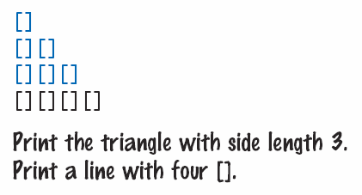
Recursive Triangle Example
public static void printTriangle(int sideLength)
{
if (sideLength < 1) { return; }
printTriangle(sideLength - 1);
for (int i = 0; i < sideLength; i++)
{
System.out.print("[]");
}
System.out.println();
}
Special Case
Recursive Call
The method will call itself (and not output anything) until sideLength becomes < 1
It will then use the return statement and each of the previous iterations will print their results
1, 2, 3 then 4

Slide 48
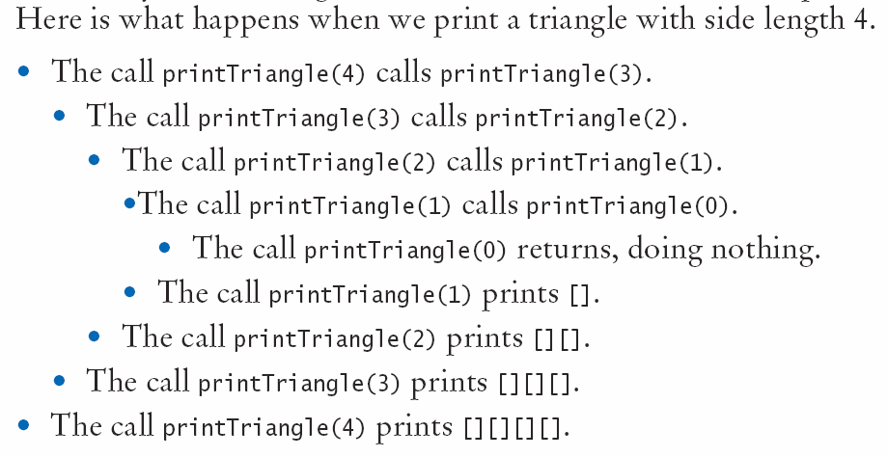
Recursive Calls and Returns

Slide 49
Summary: Methods
A method is a named sequence of instructions.
Parameter values are supplied when a method is called. The return value is the result that the method computes.
When declaring a method, you provide a name for the method, a name and type for each parameter, and a type for the result.
Method comments explain the purpose of the method, the meaning of the parameters and return value, as well as any special requirements.
Parameter variables hold the parameter values supplied in the method call.

Slide 50
Summary: Method Returns
The return statement terminates a method call and yields the method result.
Turn computations that can be reused into methods.
Use a return type of void to indicate that a method does not return a value.
Use the process of stepwise refinement to decompose complex tasks into simpler ones.

Slide 51
Summary: Scope
Local variables declared inside one method are not visible to code inside other methods
The scope of a variable is the part of the program in which it is visible.
Two local or parameter variables can have the same name, provided that their scopes do not overlap.
You can use the same variable name within different methods since their scope does not overlap.

Slide 52
Summary: Recursion
A recursive computation solves a problem by using the solution of the same problem with simpler inputs.
For a recursion to terminate, there must be special cases for the simplest inputs.
The key to finding a recursive solution is reducing the input to a simpler input for the same problem.
When designing a recursive solution, do not worry about multiple nested calls. Simply focus on reducing a problem to a slightly simpler one.

